Slide 2
Module 6: Introduction to SQL Day 2

Slide 3
Agenda 25.10.2022
from | to | topic
9:00 | 9:15 | Introduction
9:15 | 12:30 | Self Study Block
~10:30 | ~10:45 | Coffee break
12:00 | 12:30 | Discussion Block: Self Study Session
12:30 | ~13:00 | Lunch Break
13:00 | 13:30 | Content Questions
13:30 | 16:00 | Excecise Block
16:00 | 17:00 | Discussion Block : Excercise

Slide 4
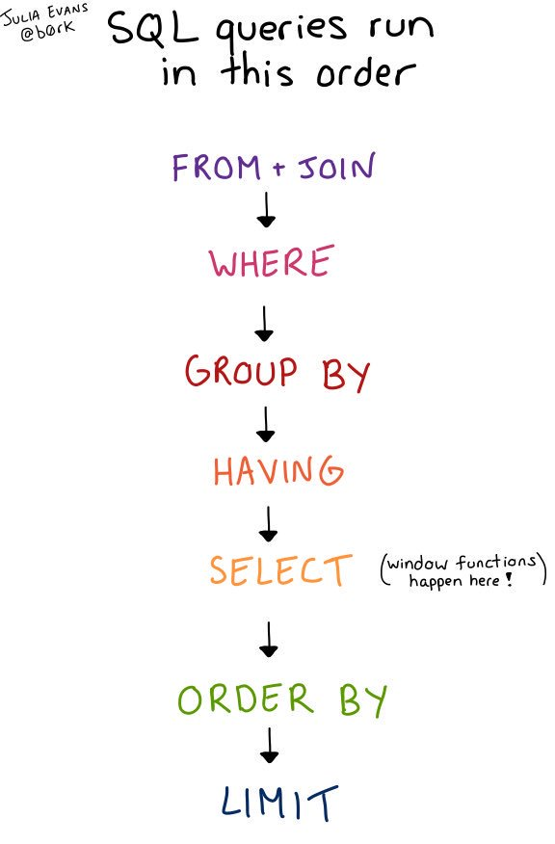
Topics for today in Brief
Select: SELECT statements are used to fetch data from a database.
Insert: The INSERT statement inserts a new row into a table. We can use the INSERT statement when you want to add new records.
Where: The WHERE clause is used to filter records. It is used to extract only those records that fulfill a specified condition.
Operators: An operator is a reserved word or a character used primarily in an SQL statement's WHERE clause to perform operation(s), such as comparisons and arithmetic operations.
Yakha GmbH

Slide 5
Material
Watch the videos 12-20 of the below playlist:
https://www.youtube.com/playlist?list=PL_RGaFnxSHWr_6xTfF2FrIw-NAOo3iWMy
Go through the below training material- ´SQL SELECT Distinct´ to ´SQL NULL Values´:
https://www.w3schools.com/sql/sql_select.asp
Yakha GmbH

Slide 6
Questions
Answer the below questions:
What is the difference between DELETE and TRUNCATE statements?
What is the difference between TRUNCATE and DROP statements?
Is a blank space or zero the same as a NULL value?
What are SQL comments?
Write a query to create a new empty table using an existing table.
What are SQL operators?
What are the different Clauses used in SQL?
Yakha GmbH

Slide 7
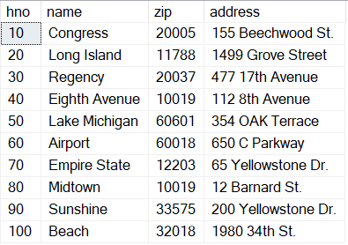
Exercise
Create a new database Hotels and create the below tables and add data to them:
City (zip, name, state)
Customer (cno, title, firstname, name, zip, address)
Hotel (hno, name, zip, address)
Reservation (rno, cno, hno, type, arrival, departure)
Room (hno, type, free, price)
Hotel
Yakha GmbH

Slide 8
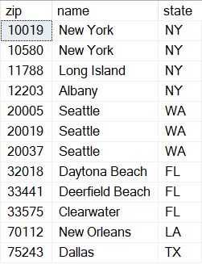
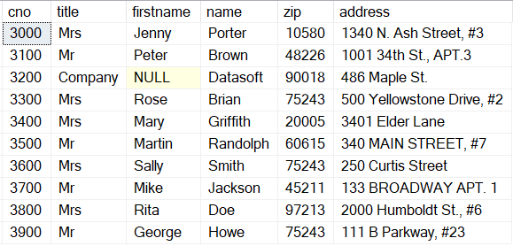
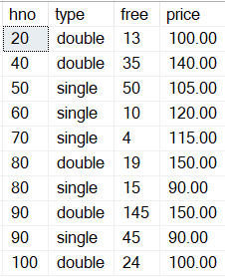
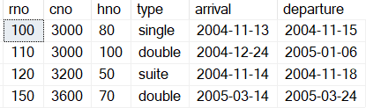
Tables
City
Customer
Room
Reservation
Yakha GmbH

Slide 9
Exercise
Write a query to display the First Name and Last Name from employees tables.
Write a query to get unique department ID from employee table.
Write a query to get all employee details from the employee table order by first name, descending.
Write a query to get the first_name, last_name, salary, PF of all the employees (PF is calculated as 15% of salary).
Write a query to get the employee ID, names (first_name, last_name), salary in ascending order of salary.
Write a query to get the all employee details who have salary more than 7800 and have department id ‘100’
Write a query to all details of the employees who work as ‘IT_PROG’ or ‘ST_CLERK’.
Yakha GmbH

Slide 10
Exercise
Write a query to get all the details of the employees who have manager ID as 121 or 122 and department id as 50
Write a query to get the number of employees working with the company.
Write a query to get the number of jobs available in the employees table.
Write a query to calculate 171*214+625
Yakha GmbH

Slide 11
Good luck!
Dein yakha Team

